Slide 1
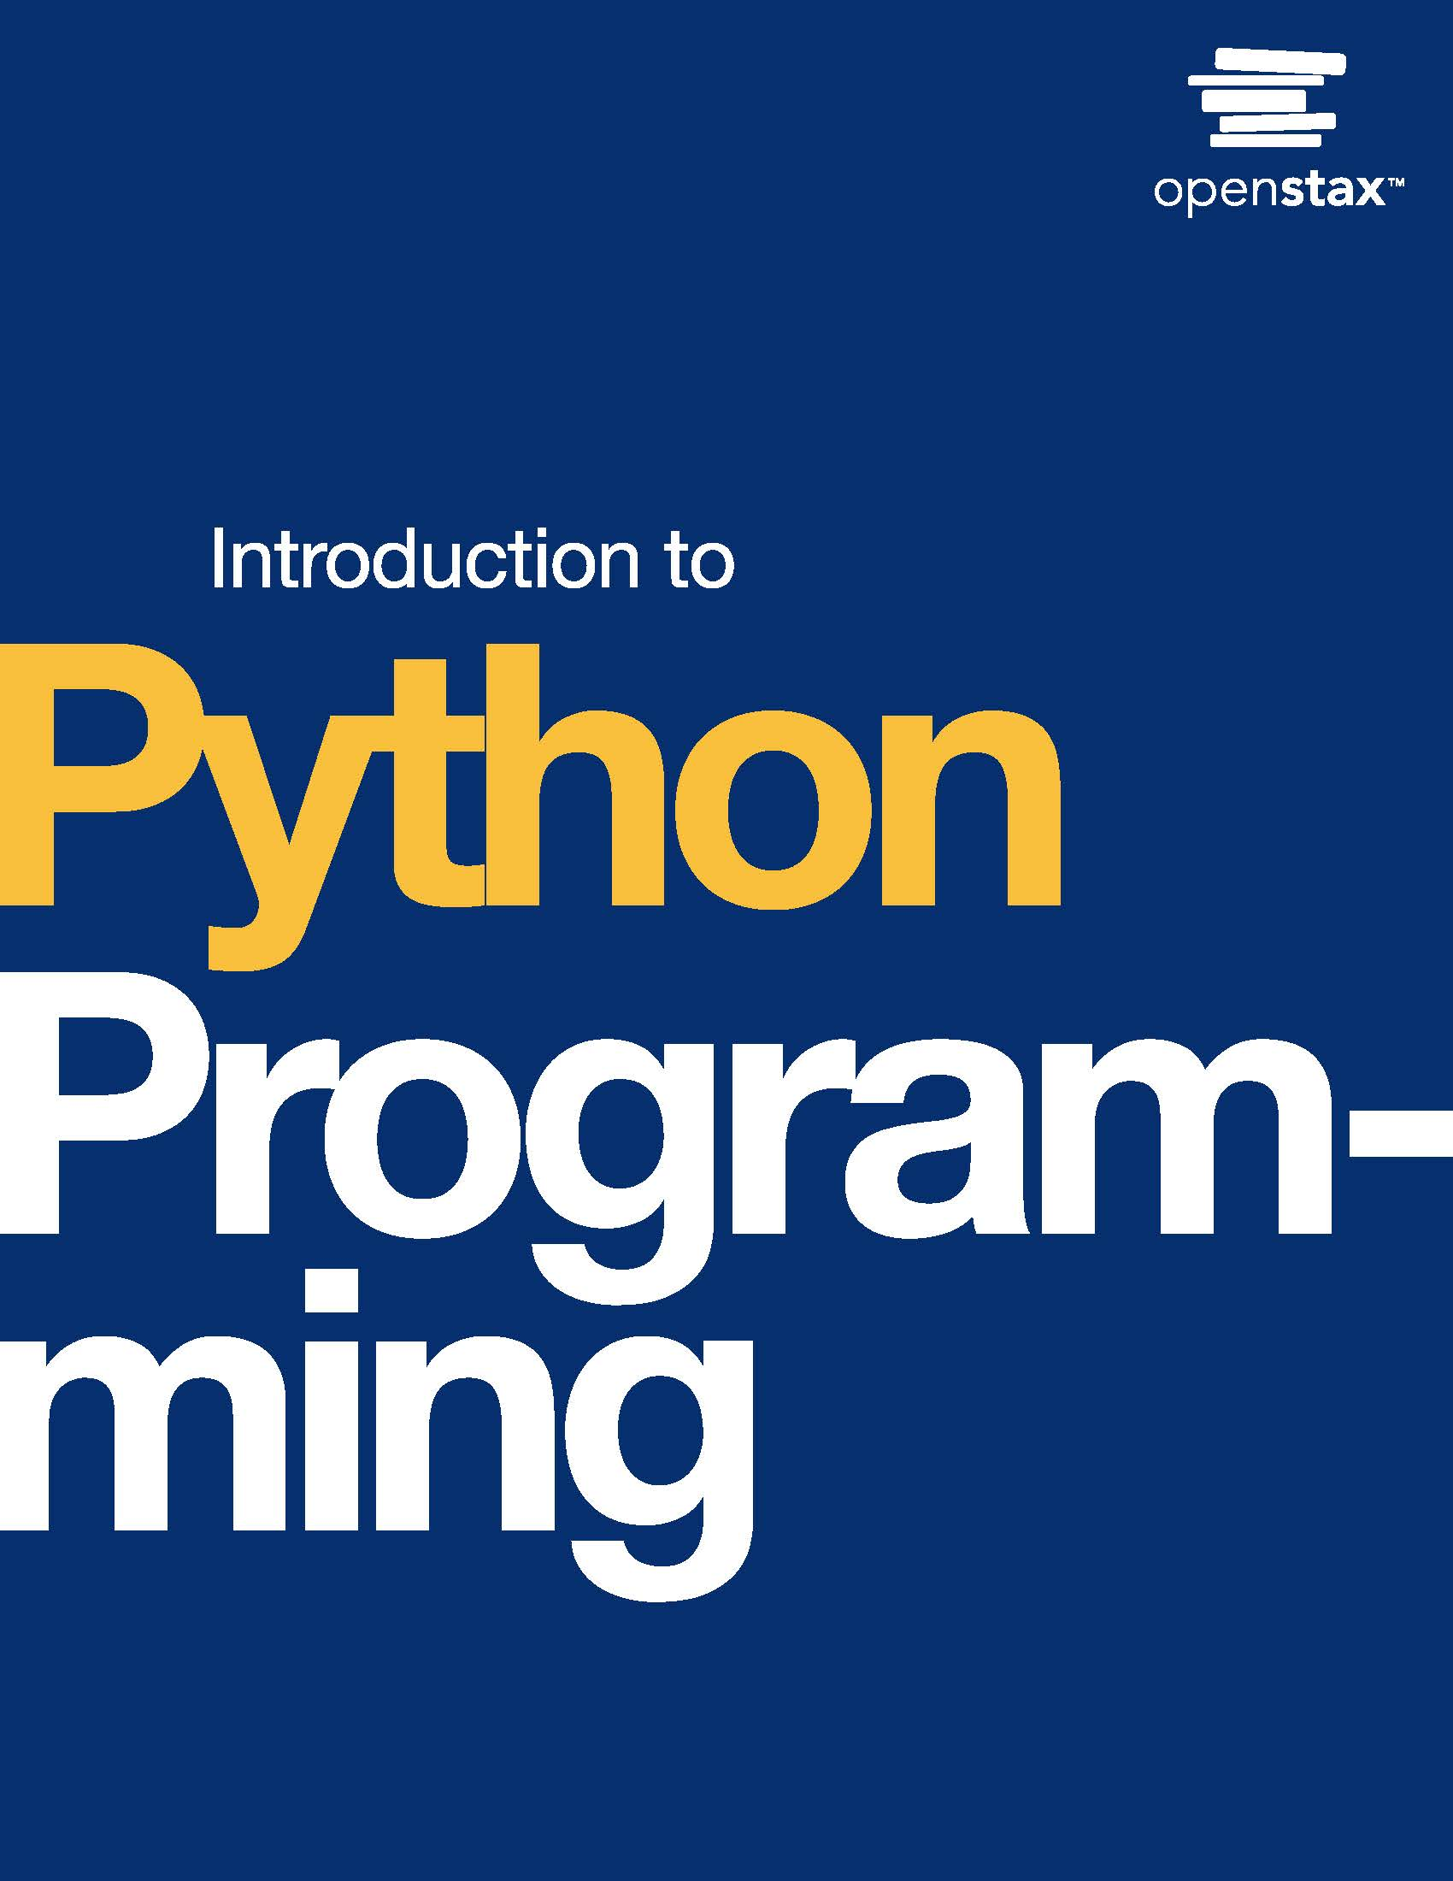
Introduction to Python Programming
Chapter 10: Dictionaries

Slide 2
Chapter outline
Dictionary basics
Dictionary creation
Dictionary operations
Conditionals and looping in dictionaries
Nested dictionaries and dictionary comprehension

Slide 3
10.1 Dictionary basics
Learning Objectives
Describe the structure of a dictionary object.
Use type() to identify the type of a dictionary object.
Explain why a dictionary object does not have duplicate key values.

Slide 4
10.1 Dictionary basics
A dictionary in Python is a container object including key-value pairs.
An example of a key-value item is a word in an English dictionary with its corresponding definition.
The dict type implements a dictionary in Python. Since a dictionary object is used to look up values using keys, a dictionary object cannot hold duplicate key values.

Slide 5
10.2 Dictionary creation
Learning Objectives
Create a dictionary object with given key/value pairs.

Slide 6
10.2 Dictionary creation
Two methods exist for creating an empty dictionary:
Using curly braces {}. Ex: dict_1 = {}.
Using the dict() function. Ex: dict_2 = dict().
A dictionary object can also be created with initial key-value pairs enclosed in curly braces.
Ex: my_dict = {"pizza": 2, "pasta": 3, "drink": 4} creates a dictionary object my_dict. A key and associated value are separated by a colon, and key-value pairs are separated by commas.

Slide 7
10.3 Dictionary operations
Learning Objectives
Recognize that a dictionary object is mutable.
Evaluate dictionary items, keys, and values.
Demonstrate the ability to access, evaluate, and modify dictionary items.
Modify a dictionary by adding items.
Modify a dictionary by removing items.

Slide 8
10.3 Dictionary operations
Accessing dictionary items
In Python, values associated with keys in a dictionary can be accessed using the keys as indexes. Here are two ways to access dictionary items in Python:
Square bracket notation: Square brackets [] with the key inside access the value associated with that key. If the key is not found, an exception will be thrown.
get() method: The get() method is called with the key as an argument to access the value associated with that key. If the key is not found, the method returns None by default, or a default value specified as the second argument.

Slide 9
10.3 Dictionary operations
Ex: In the code below, a dictionary object my_dict is initialized with items {"apple": 2, "banana": 3, "orange": 4}. The square bracket notation and get() method are used to access values associated with the keys "banana" and "apple", respectively. When accessing the dictionary to obtain the key "pineapple", -1 is returned since the key does not exist in the dictionary.
my_dict = {"apple": 2, "banana": 3, "orange": 4} print(my_dict["banana"]) # Prints: 3 print(my_dict.get("apple")) # Prints: 2 print(my_dict.get("pineapple", -1)) # Prints: -1

Slide 10
10.3 Dictionary operations
In Python, a dictionary is a mutable data type, which means that a dictionary's content can be modified after creation. Dictionary items can be added, updated, or deleted from a dictionary after a dictionary object is created.
To add an item to a dictionary, either the square bracket notation or update() function can be used.
Square bracket notation: When using square brackets to create a new key object and assign a value to the key, the new key-value pair will be added to the dictionary. my_dict = {"apple": 2, "banana": 3, "orange": 4} my_dict["pineapple"] = 1 print(my_dict) # Prints: {"apple": 2, "banana": 3, "orange": 4, "pineapple": 1}
update() method: the update() method can be called with additional key-value pairs to update the dictionary content. my_dict = {"apple": 2, "banana": 3, "orange": 4} my_dict.update({"pineapple": 1, "cherry": 0}) print(my_dict) # Prints: {"apple": 2, "banana": 3, "orange": 4, "pineapple": 1, "cherry": 0}

Slide 11
10.3 Dictionary operations
To modify a dictionary item, the two approaches above can be used on an existing dictionary key along with the updated value.
Ex:
Square bracket notation: my_dict = {"apple": 2, "banana": 3, "orange": 4} my_dict["apple"] = 1 print(my_dict) # Prints: {"apple": 1, "banana": 3, "orange": 4}
update() method: my_dict = {"apple": 2, "banana": 3, "orange": 4} my_dict.update({"apple": 1}) print(my_dict) # Prints: {"apple": 1, "banana": 3, "orange": 4}
Items can be deleted from a dictionary using the del keyword or the pop() method.
del keyword: my_dict = {"apple": 2, "banana": 3, "orange": 4} del my_dict["orange"] print(my_dict) # Prints: {"apple": 2, "banana": 3}
pop() method: my_dict = {"apple": 2, "banana": 3, "orange": 4} deleted_value = my_dict.pop("banana") print(deleted_value) # Prints: 3 print(my_dict) # Output: {"apple": 2, "orange": 4}

Slide 12
10.4 Conditionals and looping in dictionaries
Learning Objectives
Write a conditional statement to check for a key/value.
Write a for loop to iterate over elements of a dictionary.

Slide 13
10.4 Conditionals and looping in dictionaries
Conditionals for dictionary
Conditional statements can be used with dictionaries to check if certain keys, values, or dictionary items exist in the dictionary or if a value satisfies a particular condition.
Looping on a dictionary
Looping over a Python dictionary is a way to iterate through key-value pairs in the dictionary.
Looping in a dictionary can be done by iterating over keys or items. When looping using keys, keys are obtained using the keys() function and are passed to the loop variable one at a time.
When looping over items using the items() function, both the key and value for each item are passed to the loop variable.

Slide 14
10.5 Nested dictionaries and dictionary comprehension
Learning Objectives
Explain the structure of nested dictionaries.
Use dictionary comprehension to create a dictionary object.

Slide 15
10.5 Nested dictionaries and dictionary comprehension
Nested dictionaries
As described before, Python dictionaries are a type of data structure that allows for storing data in key-value pairs.
Nested dictionaries are dictionaries that are stored as values within another dictionary.
Ex: An organizational chart with keys being different departments and values being dictionaries of employees in a given department. For storing employee information in a department, a dictionary can be used with keys being employee IDs and values being employee names.

Slide 16
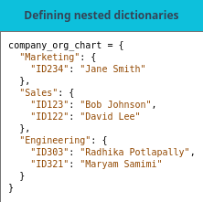
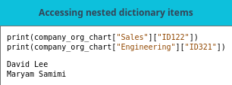
Table 10.8 and 10.9
The tables below outline the structure of such nested dictionaries and how nested values can be accessed.

Slide 17
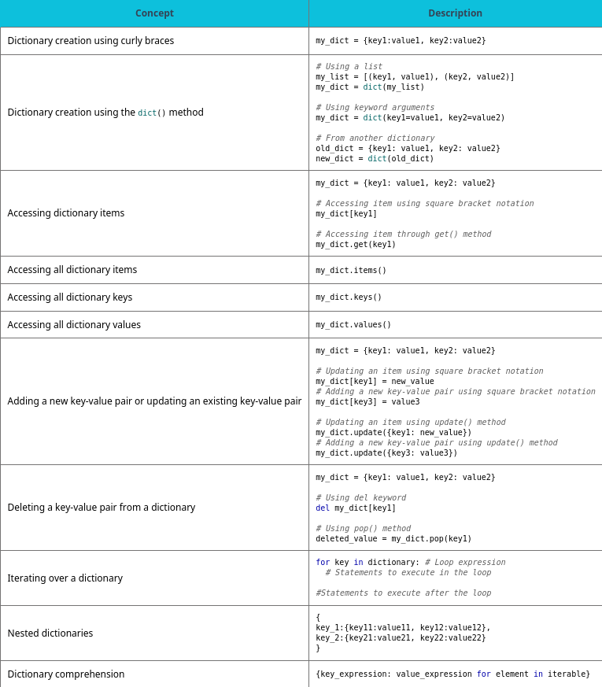
Table 10.10 Chapter 10 reference.

Slide 18
This ancillary resource is licensed under a Creative Commons Attribution-NonCommercial-ShareAlike 4.0 (CC BY NC-SA) license; it may be distributed, remixed, built upon for noncommercial purposes only, and must be attributed to OpenStax and redistributed under the same license.

